Slide 1

Mini Project on Air Quality Prediction using Machine Learning Approach(Under the mentorship of Dr. J Sathish Kumar)
Presented By:
Sanat Kumar(20174066)
Sudhanshu Singh(20174076)
Swatantra GC(20174101)
Manish Praveen Barla (20154110)

Slide 2

Table of Content
Abstract
Origin of the Project
Importance of the Project
About Machine Learning
Machine Learning Algorithms
Terminologies used
Work on the model
Implementation
Conclusion

Slide 3
Abstract
As air pollution is a complex mixture of toxic components with considerable impact on humans, forecasting air pollution concentration emerges as a priority for improving life quality.
As the technology is growing very fast so everything is happening quickly. Now everything is handled with data. We have a large set of data available in every field called dataset and here computer science play a very important role in managing and storing the data. We are using Machine Learning technology to do our project on Air Quality Prediction.
We have used machine learning algorithms and applied that to predict our target value (in this case our target value is ozone O3) . We applied several machine learning algorithms and calculated the error generated on test data and tried to minimize the error using some parameter tuning.

Slide 4
Origin of the Project
Atmospheric pollution has become a major cause of premature mortality among the general public resulting in millions of deaths every year(WHO reports). In addition to those who suffer from asthma, cardiovascular problems, and respiratory issues, infants and aged population are at greater risk of being prone to hazardous effects of atmospheric pollution. In this case, development of machine learning models can be crucial to effectively estimate and predict the pollution concentration. With air pollution modeling, one can estimate the level of air pollution and assess its impact on the environment and human health.

Slide 5
Importance of the Project
Since air pollution is a major issue in urban areas. if we ignore this, it will lead to a dangerous future. Sometimes we don't have enough information to get the result due to lack of proper equipment/kits or due to faulty equipment. In such cases, we have two options: either we can ignore the outcome or we can predict some outcome which is closer to the actual result(which we would have found if we have used proper equipment). But ignoring the outcome is not a good thing. It is better to go far second one and in this case machine learning is very useful. We can build our model to predict some outcome and use it to solve our problem.

Slide 6
About Machine Learning
Machine Learning provides computer systems the ability to automatically learn and improve from the experience(data).
Machine Learning is also the subset of Artificial Intelligence.
Type of Machine Learning:
Supervised Machine Learning
Unsupervised Machine Learning
Reinforcement Machine Learning
Here in our project we are using Supervised Machine Learning with Python Language to make our model.

Slide 7
Machine Learning Algorithms
Machine learning algorithms used in the project:
1) Decision Tree
2) Random Forest
3) XGBoost

Slide 8
Python Libraries used:
Matplotlib
Scikit Learn
Pandas

Slide 9
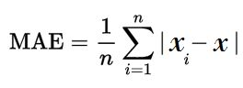
Terminologies used
Mean absolute error: mean absolute error (MAE) is a measure of error between paired observations expressing the same phenomenon. Examples of Y versus X include comparisons of predicted versus observed: Formula: x: actual value xi : predicted value

Slide 10
Terminologies used
Model validation: In most applications, the relevant measure of model quality is predictive accuracy. In other words, will the model's predictions be close to what actually happens. We have splitted the data into two parts: one part is used for training the model, the other is used for validation purposes

Slide 11
Terminologies used
Cross-validation: In cross-validation , we run our modeling process on different subsets of the data to get multiple measures of model quality. For example, we could begin by dividing the data into 5 pieces, each 20% of the full dataset.
In this case, we say that we have broken the data into 5 " folds"

Slide 12
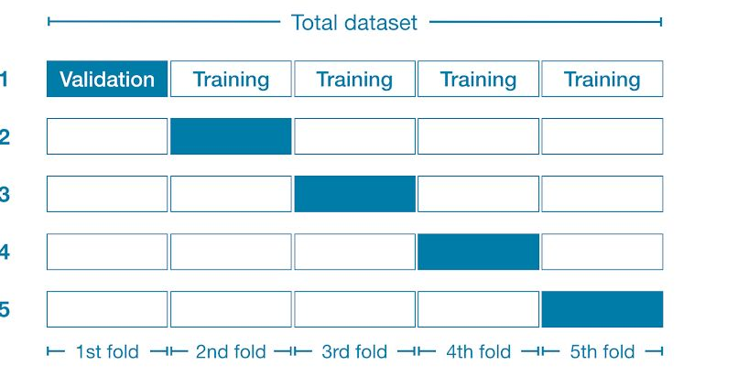

Slide 13
Terminologies used
In the first experiment, the first fold is used for validation and rest folds are used for training purpose. In the second experiment 2nd fold is used for validation purpose and rest folds are used for training purpose. We repeat this process, using every fold once as the holdout set. Putting this together, 100% of the data is used as holdout at some point, and we end up with a measure of model quality that is based on all of the rows in the dataset (even if we don't use all rows simultaneously). In our case, since the dataset has more than 9000 rows therefore we have made 10 folds.

Slide 14
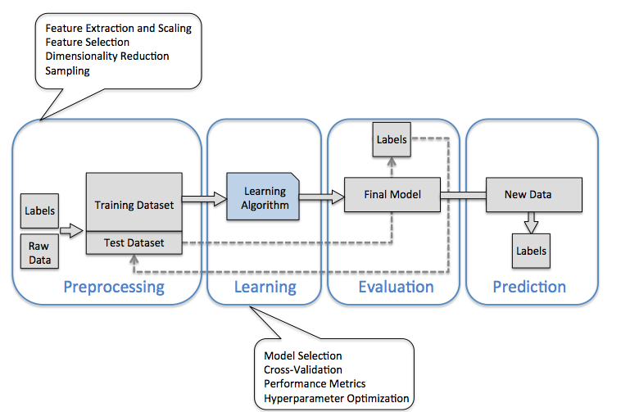
Work on the model implementation

Slide 15
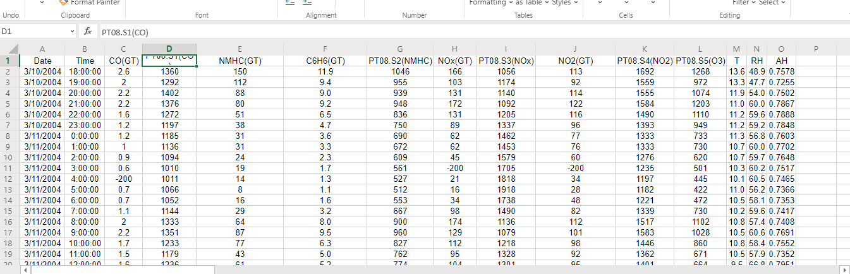
Dataset sample

Slide 16
Implementation
1) DecisionTree: First we have applied the Decision tree and calculated error for various depths. There are various methods to calculate error in prediction. In our case, I have used mean absolute error(MAE).

Slide 17
Implementation using Decision Tree
# creating cross validation on DecisionTree
from sklearn.model_selection import cross_val_score
from sklearn.tree import DecisionTreeRegressor
from sklearn.metrics import mean_squared_error, r2_score
# We have calculated MAE for different various depth for tree and plotted a graph for that
result = list()
depth = [10 , 50, 100, 150 , 200, 250 , 300, 350 ,400 , 450, 500]

Slide 18
Implementation using Decision Tree
for d in depth:
scores = -1 * cross_val_score(DecisionTreeRegressor(max_depth=d), X, y,cv=10, scoring='neg_mean_absolute_error')
result.append(scores.mean())
print(result)

Slide 19
Implementation using Decision Tree
# error is about 33-34%
plt.plot(depth , result )
plt.xlabel("Depth")
plt.ylabel("MAE")
plt.title("plot of MAE vs Depth in decision tree")
plt.show()
MAE of each depth:
[114.84708142617367, 129.74356174870883, 128.37719479866539, 128.46991018785135, 128.24894533571006, 128.76330693815987, 128.47096987979342, 129.46922585584352, 129.0060338680927, 128.9110850587321, 128.7298043786279]

Slide 20
Table for various depths and corresponding MAE
DEPTH | MAE(mean absolute error)
10 | 114.84708142617367
50 | 129.74356174870883
100 | 128.37719479866539
150 | 128.46991018785135
200 | 128.24894533571006
250 | 128.76330693815987
300 | 128.47096987979342
350 | 129.46922585584352
400 | 129.0060338680927
450 | 128.9110850587321
500 | 128.7298043786279

Slide 21
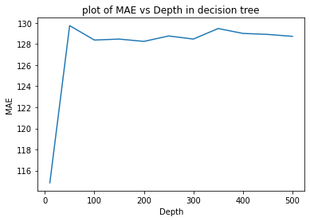

Slide 22
Implementation
2) RandomForest: After that we have applied random forest and calculated MAE for various estimators

Slide 23
Implementation using Random Forest
# we have applied random forest
from sklearn.ensemble import RandomForestRegressor
estimator = [250 , 300, 400 , 500 , 750 , 1000 ]
result2=list()
for est in estimator:
scores = -1 * cross_val_score(RandomForestRegressor(n_estimators=est,random_state=1), X, y, cv=10, scoring='neg_mean_absolute_error')
result2.append(scores.mean())
print(result2)

Slide 24
Implementation using Random Forest
plt.plot(estimator , result2)
plt.xlabel("Depth")
plt.ylabel("MAE")
plt.title("plot of MAE vs Depth in RandomForest")
plt.show()
MAE for estimators[93.49311200999436, 93.13936243258377, 93.18544262169203, 93.07874177445649, 93.02108580145344, 92.95651470885323, 92.94626139905846, 92.9644205089355]

Slide 25
Table for various estimators and corresponding MAE
Estimator | MAE
250 | 93.18544262169203
300 | 93.07874177445649
400 | 93.02108580145344
500 | 92.95651470885323
750 | 92.94626139905846
1000 | 92.9644205089355

Slide 26
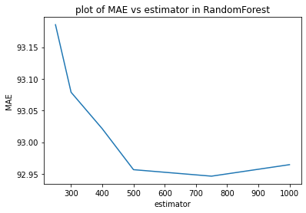

Slide 27
Implementation
3) XGBoost: We have applied XGBoost for various estimators and calculated MAE. After observation we have found that XGBoost performs better than others.

Slide 28
Implementation using XGBoost
# XGBRegressor
from xgboost import XGBRegressor
result3=list()
estimator2 = [ 400 , 500 , 750 , 1000 , 1200 , 1500 ]
for est in estimator2:
scores = -1 * cross_val_score(XGBRegressor(n_estimators=est, learning_rate=0.05), X, y,
cv=10, scoring='neg_mean_absolute_error')
result3.append(scores.mean())
print(result3)

Slide 29
Implementation using XGBoost
plt.plot(estimator2 , result3)
plt.xlabel("estimator")
plt.ylabel("MAE")
plt.title("plot of MAE vs estimator in XGBoost")
plt.show()
MAE for each estimator:[92.91475309866678, 92.60042163168546, 91.72125171491555, 91.26868491217381, 91.37167221870668, 91.42314439211705]

Slide 30
Table for various estimators and corresponding MAE
Estimators | MAE
400 | 92.91475309866678
500 | 92.60042163168546
700 | 91.72125171491555
1000 | 91.26868491217381
1200 | 91.37167221870668
1500 | 91.42314439211705

Slide 31
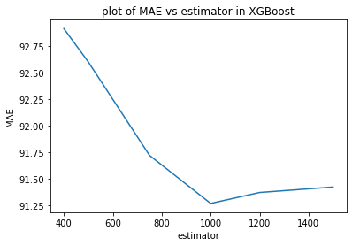

Slide 32
Conclusion
After seeing the result, we can see that XGBoost performs better with a numbers of estimators 1000 and MAE is 91.269.

Slide 33


Thank You

